Slide 1
Bayes' rule
Achilleas Tsakpinis
22.11.2022

Slide 2
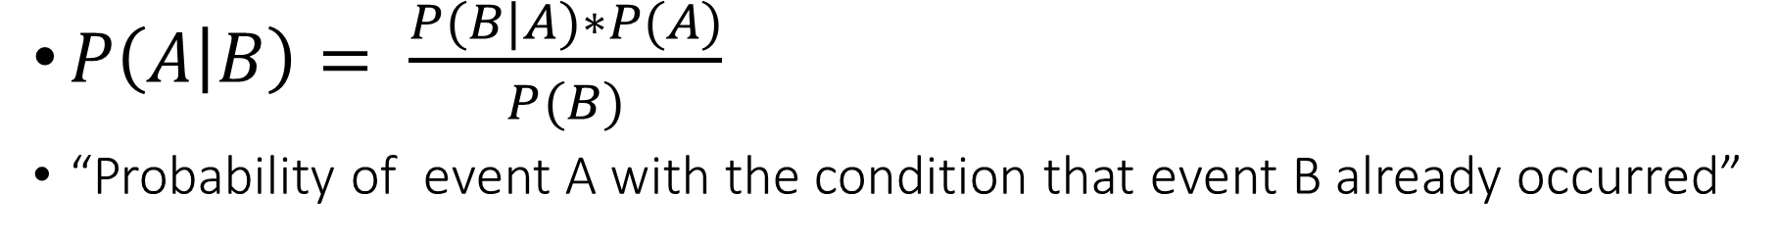
Conditional probability
$P\left(A | B\right)= \frac{P(B|A)∗P(A)}{P(B)}$
“Probability of event A with the condition that event B already occurred”

Slide 3
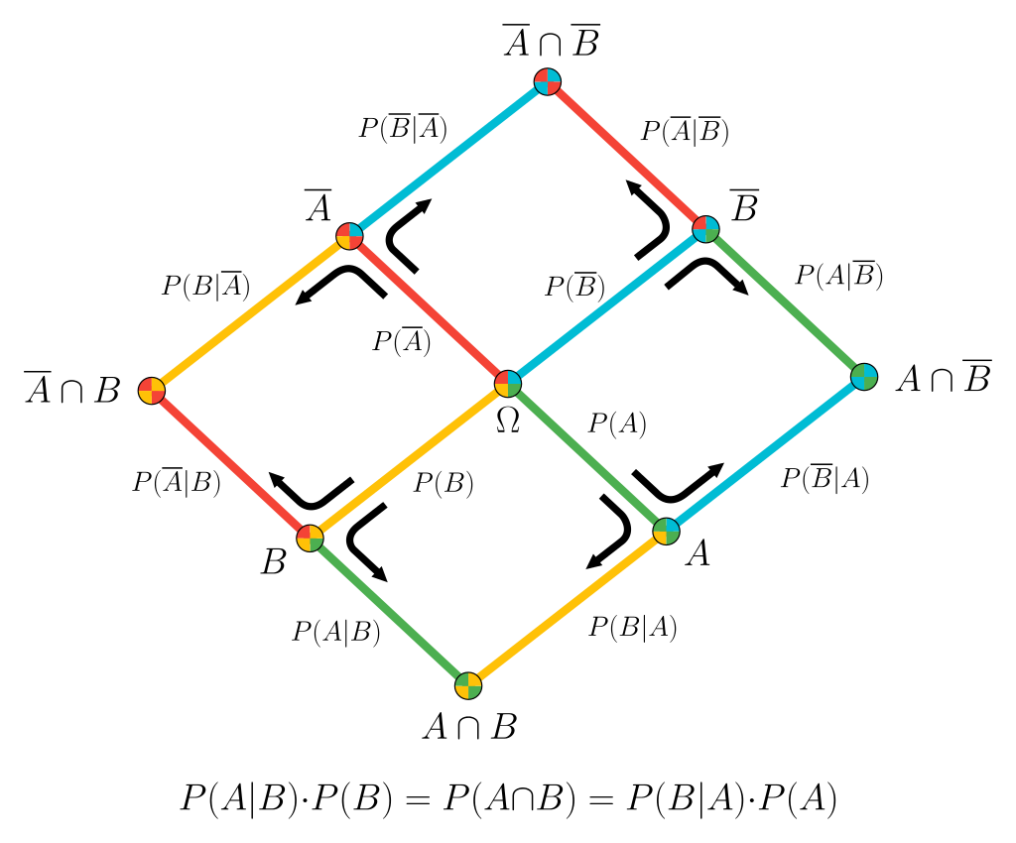
Graphical illustration

Slide 4
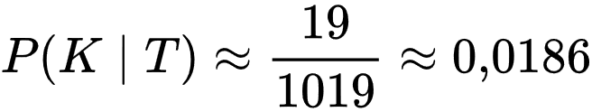
Conditional probability example
Inspected
100 000
Infected
20
Healthy
99 980
Negative Test
1
Positive Test
19
Positive Test
1000
Negative Test
98980
Positive tested: 1019
I

Slide 5

Conditional probability example
  $P\left(+ | Alcohol\right)=0.99$
  $P\left(+ | No Alcohol\right)=0.03$
  $P\left(Alcohol\right)=0.05$
  ➔$P\left(No Alcohol\right)=0.95$
  $P\left(+\right)=P\left(Alcohol\right) ∗P\left(+ | Alcohol\right)$ + $P\left(No Alcohol\right)$ * $P\left(+ | No Alcohol\right)$
  = 0.07
  ➔ $P\left(Alcohol | +\right)=$ $\frac{P(+|Alcohol)∗P(Alcohol)}{P(+)}$ = 0.63

